Slide 1
SECURE DATA HADING IN IMAGE USING STEGANOGRAPHY
CAPSTONE PROJECT
Presented By: Yadnyesh Satish Ubhad
Student Name : Yadnyesh Satish Ubhad
College Name : G H Raisoni College of Engineering Nagpur
Department : Cyber Security

Slide 2
OUTLINE
Problem Statement
Technology used
Wow factor
End users
Result
Conclusion
Git-hub Link
Future scope

Slide 3
Problem Statement
Secure communication is crucial in today's digital world. Traditional encryption methods are sometimes detectable. This project embeds secret messages inside images using steganography, ensuring undetectable data transmission.

Slide 4
Technology used
Software HardWare
Python, Flask 8 GB Ram (minimum)
OpenCV, NumPy 256 GB SSD/HDD
HTML, CSS, JavaScript Windows 11
Werkzeug for file handling Ryzen 5 Processor
VS CODE

Slide 5
Wow factors
Secure and undetectable encryption
Real-time message decryption
User-friendly web-based interface
Uses password-based protection for additional security

Slide 6
End users
Cybersecurity professionals
Intelligence agencies
Individuals requiring secure communication
Journalists & Whistleblowers

Slide 7
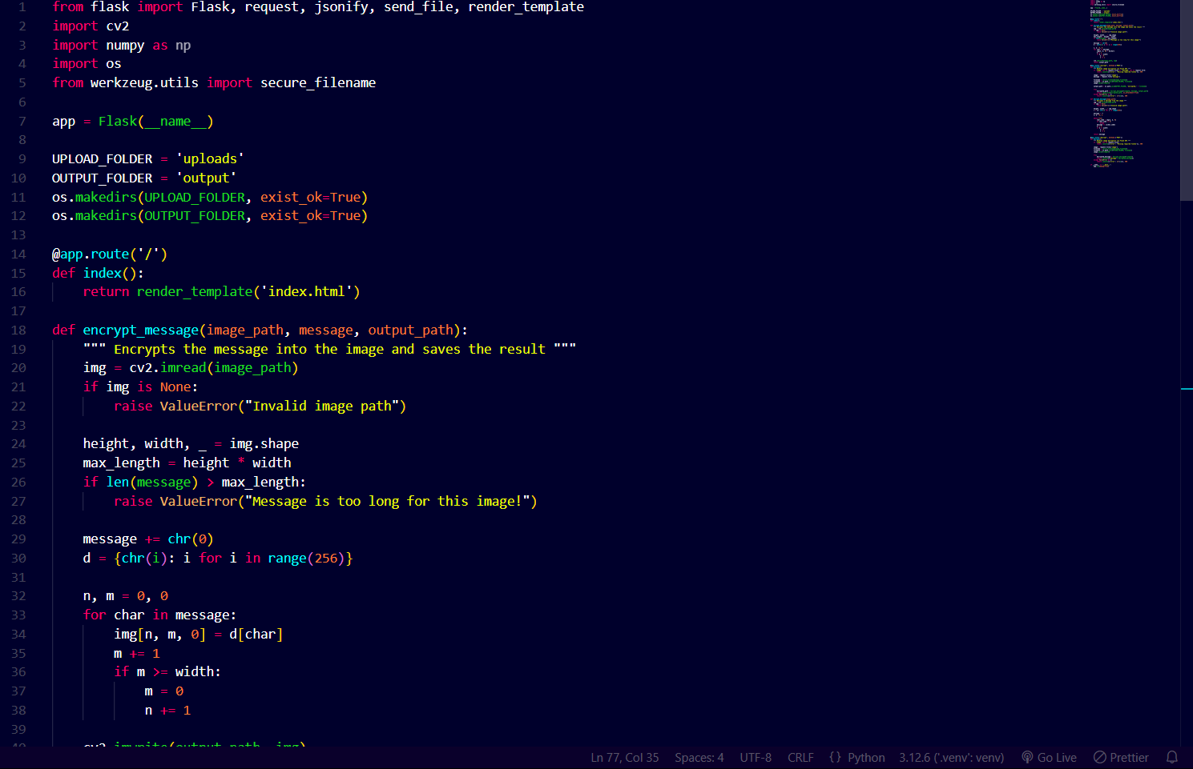
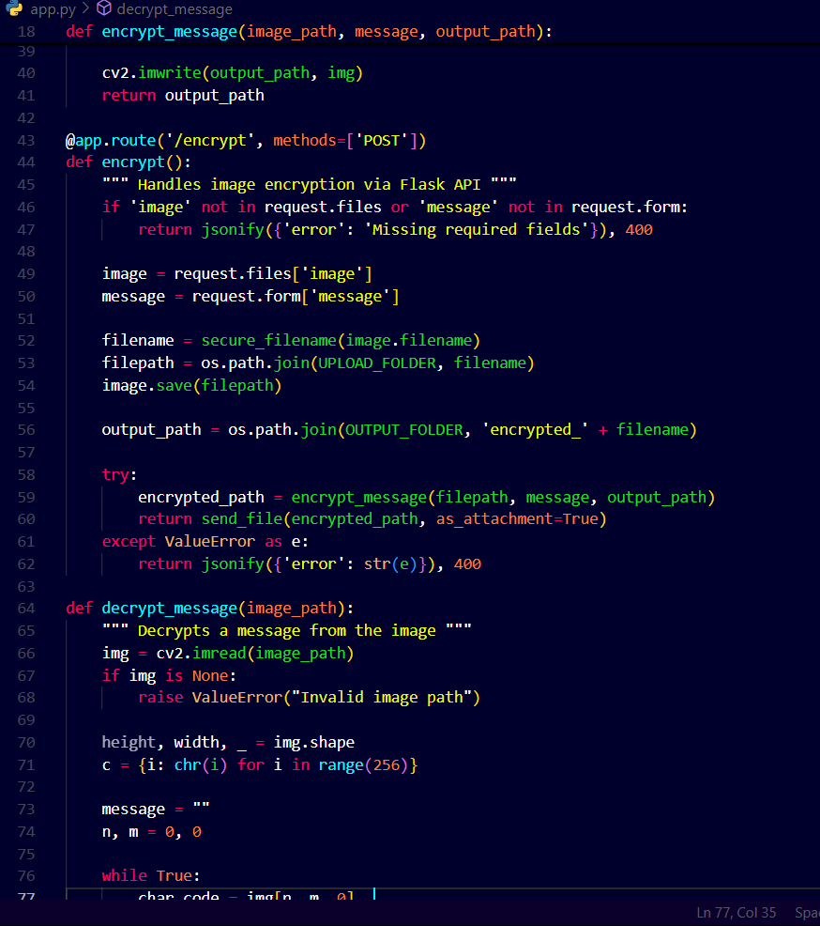
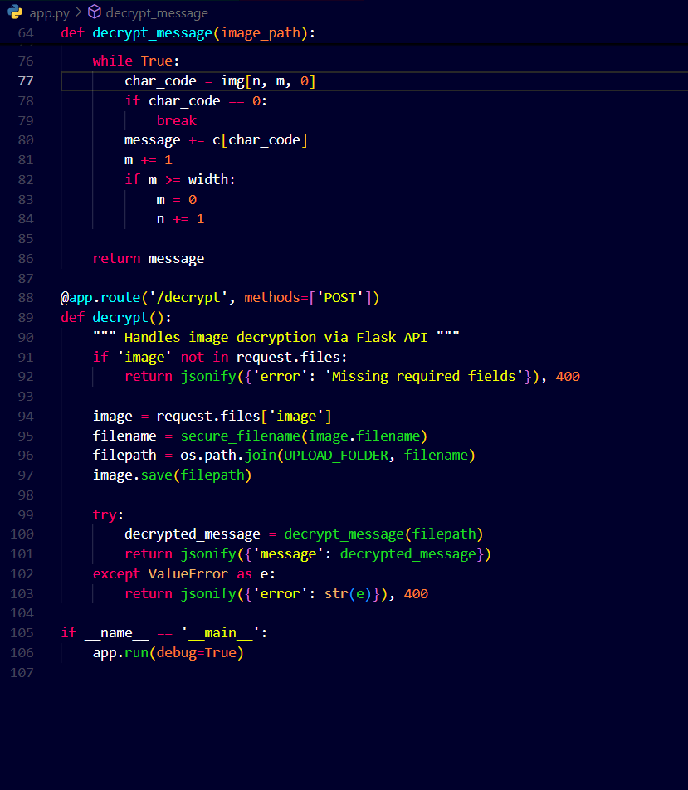
Results

Slide 8
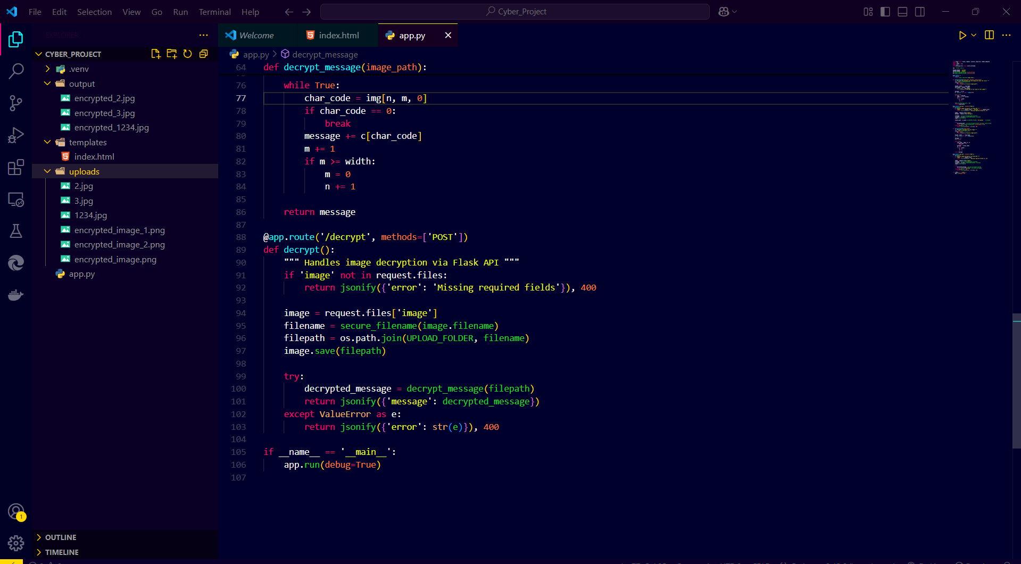
Results

Slide 9
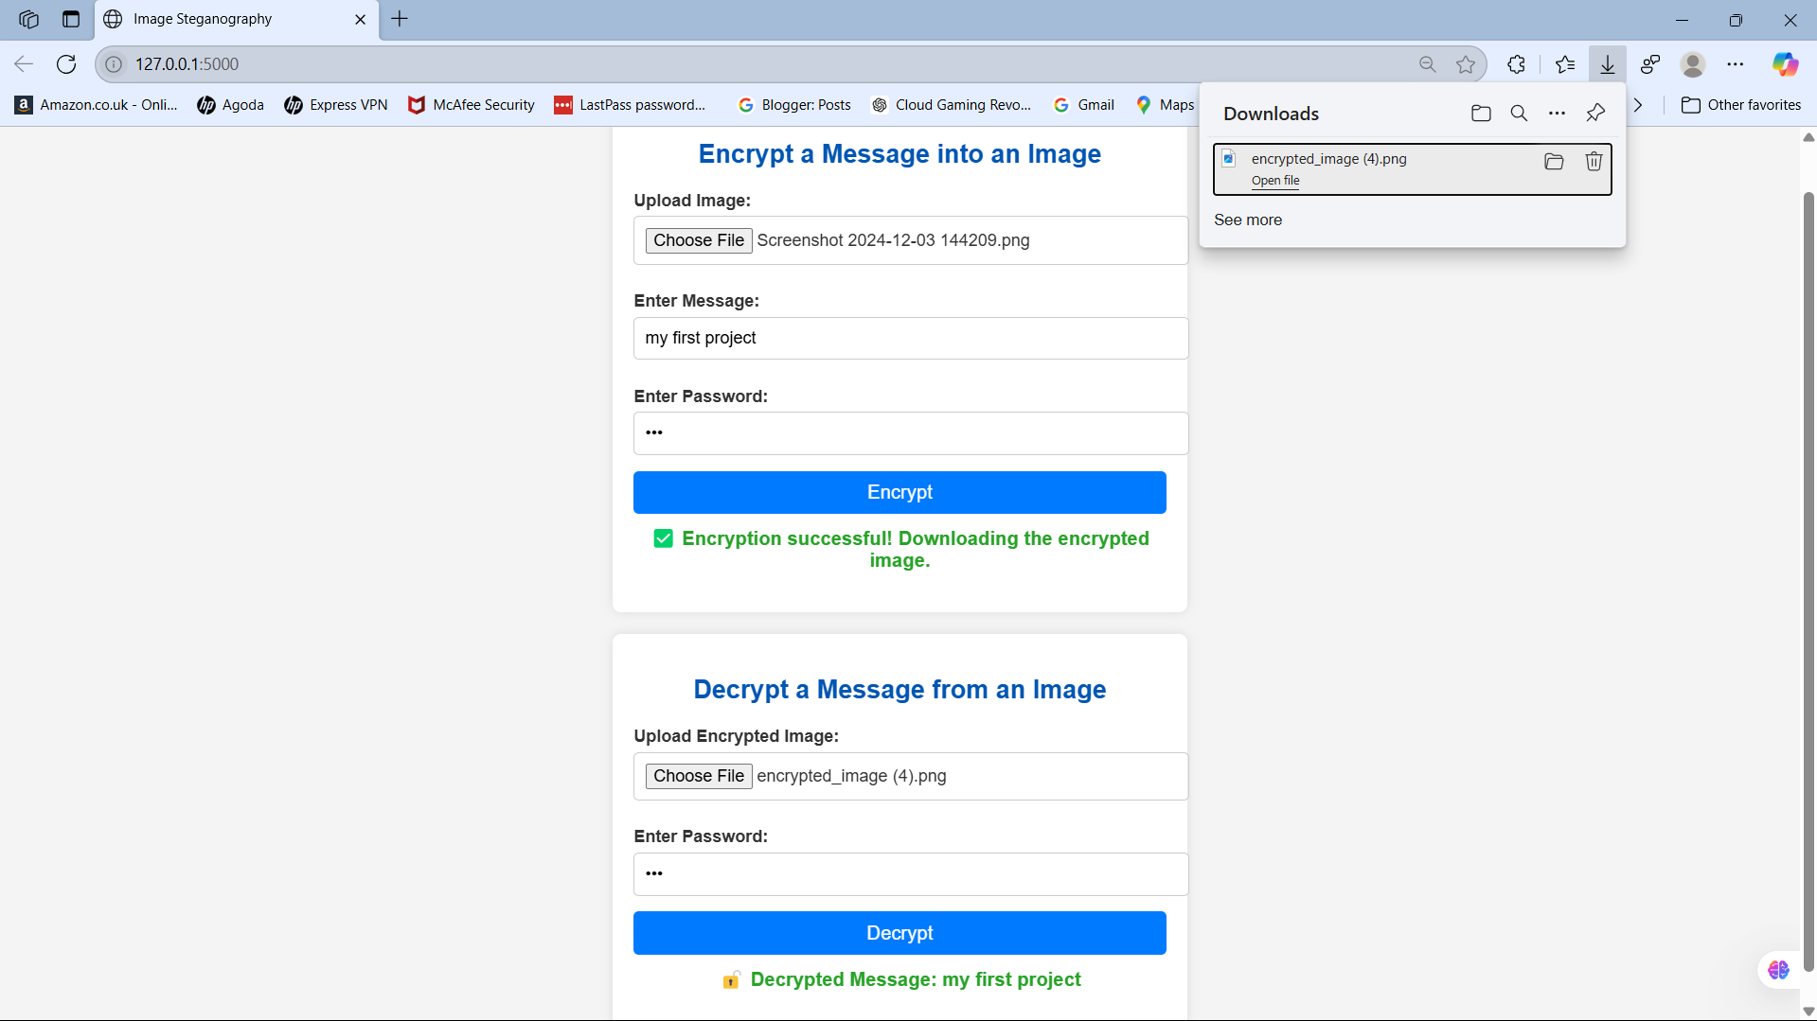
Results

Slide 10


Results
Encrypted Image
Decrypted Image

Slide 11
Conclusion
This project successfully demonstrates how steganography can enhance data security. By embedding messages inside images, users can securely transmit sensitive information without raising suspicion.

Slide 12
GitHub Link
https://github.com/YadnyeshUbhad/Image-Steganography-.git

Slide 13
Future scope(optional)
AI-based steganography for automatic image selection
Blockchain integration for tamper-proof data storage
Support for video and audio steganography
Enhanced security using advanced encryption techniques

Slide 14
THANK YOU

